Slide 1
Imaginary Surface Obstruction Analysis
Python Script Tool for ArcGIS Advanced 10.2+

Slide 2
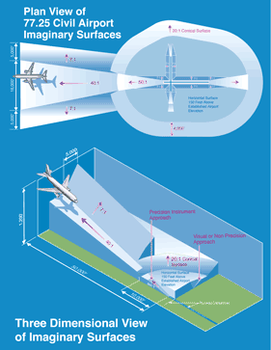
Purpose
Perform a quick estimate of potential obstructions in the imaginary surfaces (img srf) around an airfield using a 2D raster approach
Identified obstructions should be verified further using GIS measurement tools
Client or contractor should also verify with “boots on the ground”
Relatively quick and low level of effort way to determine if you should include obstructions in the img srf as a challenge or to put in the effort to analyze further/develop 3D visualization
[Source]

Slide 3
Methodology
Conduct analysis on the first 10,000 feet of the Approach Surface (AP)
Excluding the Runway Protection Zones (RPZ) and Primary Surface (PS) the first 10,000 feet of the AP is the most vulnerable to vertical obstruction encroachment [Description of Surfaces]
RPZs have their own land use restrictions which should be used for analyzing encroachment
PSs generally fall completely within the installation/airport property boundary
The AP img srf:
“…beginning at the end of the Primary Surface and extending outward and upward at a slope of 50:1 for a horizontal distance of 10,000 feet and at a slope of 40:1 for an additional 40,000 feet.”

Slide 4
Methodology
Euclidean Distance tool calculates distance from runway/PS outwards
Divide distance raster by 50 (converts it to the glide slope heights)
Add glide slope raster to runway elevation (brings the glide slope up to the appropriate elevation)
Convert obstructions point data to raster based on AGL height field
Add obstructions raster to DEM
Subtract adjusted obstructions raster from adjusted glide slope raster
Symbolize, analyze, determine if re-run/further analysis is needed

Slide 5
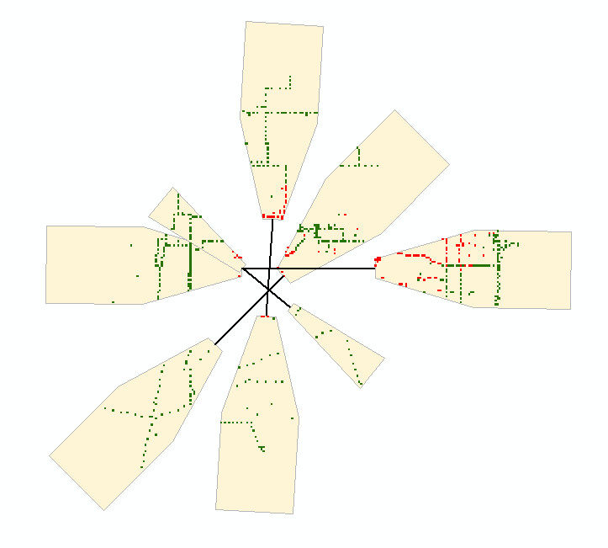
Example Output
AP
First 10,000 ft
Runway
Potential obstruction
No obstruction

Slide 6
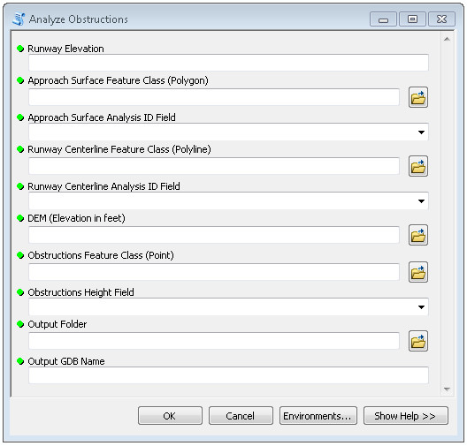
Inputs and Preconditions
All inputs should be in the same projection
The projection used should have feet as its liner unit (THIS IS CRITICAL)
I recommend the local State Plane system
Your DEM elevation values should be in FEET (may need to use raster math to convert if it is in meters, etc.)
You must be running this on a machine with ArcAdvanced and Spatial Analyst
The ArcAdvanced VM will do
See following slides on how to prep data

Slide 7
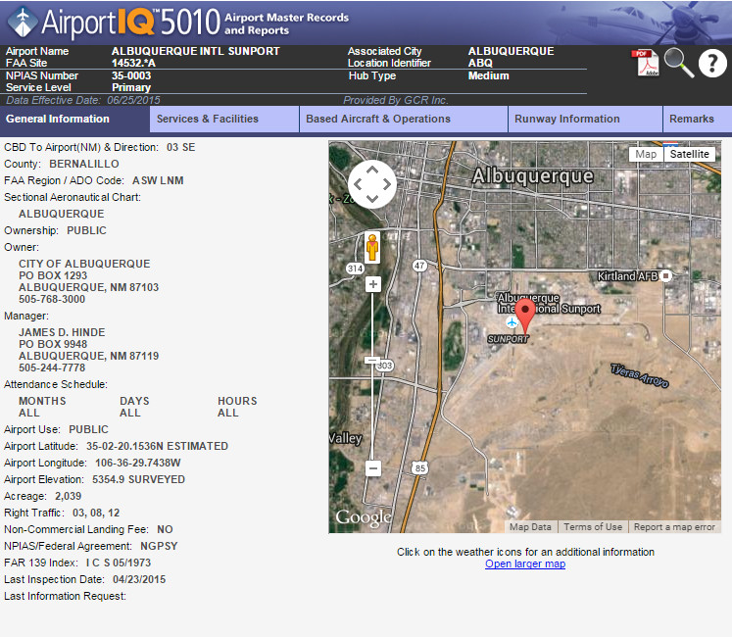
Inputs: Runway Elevation
Type: Integer (Long)
Input the elevation of the runway
This will be used to “bump up” the glide slope raster to the appropriate elevation
There are a few ways you could estimate this but the best way would be to use the designated runway elevation value
Use AirportIQ 5010 or something similar to get this value

Slide 8

Inputs: Approach Surface FC/Analysis ID Field
Type: Polygon feature class file path (not a layer – don’t drag in from TOC, drag in from catalog)
The AP feature class prepared as specified in the coming slides
You will be able to choose the Analysis ID field from a drop down
The contents of the field is explained in a coming slide
AP surfaces extracted from a full img srf dataset. Note, there are four runways at this airport and therefore there are eight APs.

Slide 9
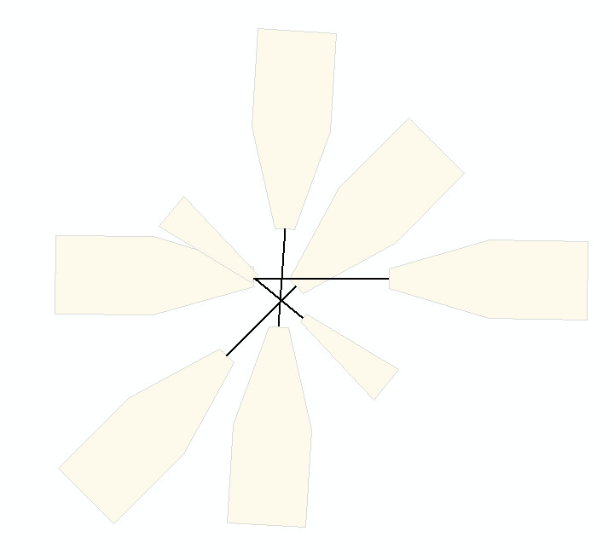
Inputs: Runway/Primary Surface Centerline FC/Analysis ID Field
Type: Polyline feature class file path (not a layer – don’t drag in from TOC, drag in from catalog)
The runway/PS centerline feature class prepared as specified in the coming slides
You will be able to choose the Analysis ID field from a drop down
The contents of the field is explained in a coming slide
Centerline is flush
Centerlines should be flush with APs. If you do not have centerline data you will have to produce it. There are a few ways to do so but I have found digitizing to be the quickest and easiest (make sure you use the snap feature!).

Slide 10
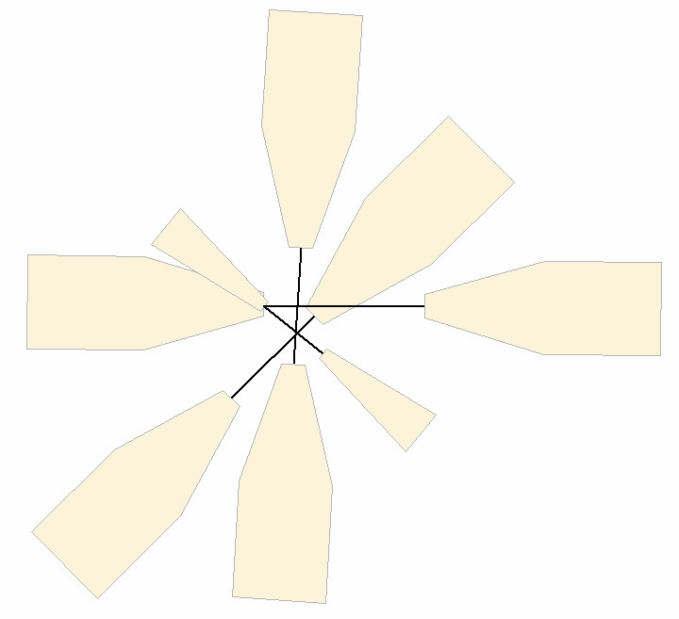

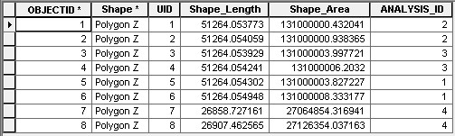
Preparing AP, Centerline, and Analysis ID Field
Extract APs from img srf dataset
Confirm that centerline data snaps to AP
If centerline data is not available, digitize it and make sure it snaps to AP
Create an ANALYSIS_ID field (name does not matter) and populate it as shown to the right
Field data type should be LONG
The number used do not matter as long as they are unique
Make IDs for an AP match the ID of the centerline connecting them
Dissolve both layers by ANALYSIS_ID field
2
2
1
4
3
3
3
1
4
4
1
2
Centerline Table
Approach Surface Table

Slide 11
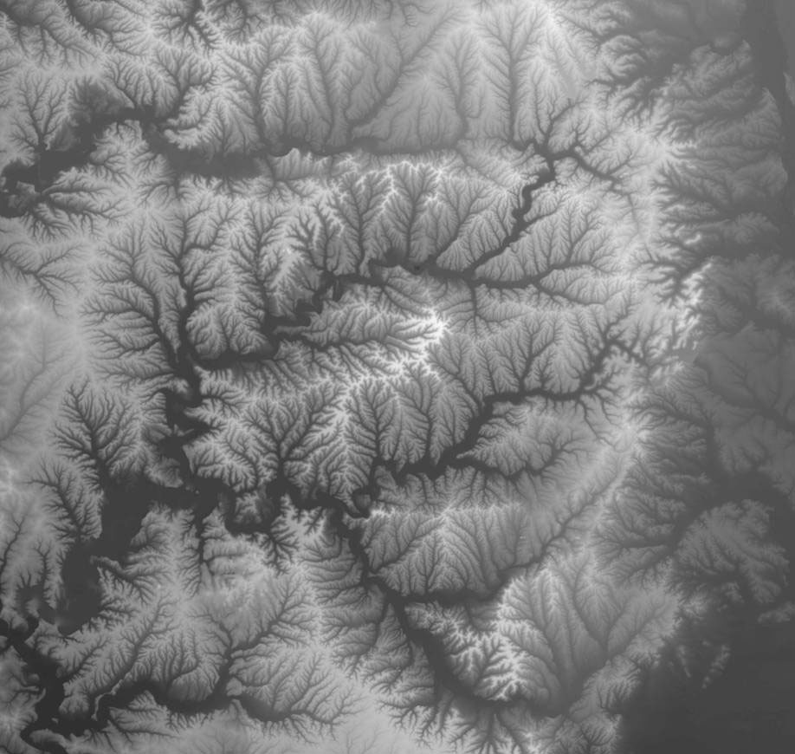
Inputs: DEM
Type: Raster dataset
Make sure that raster values of the DEM are in FEET
May require conversion using Raster Calculator
Will likely want to mask the DEM to a smaller area (e.g. the extent of the largest input)
Keep in mind that the spatial res of your DEM may be a limiting factor in regards to accuracy (i.e. courser res will yield results with a higher amount of error)
[Source]

Slide 12
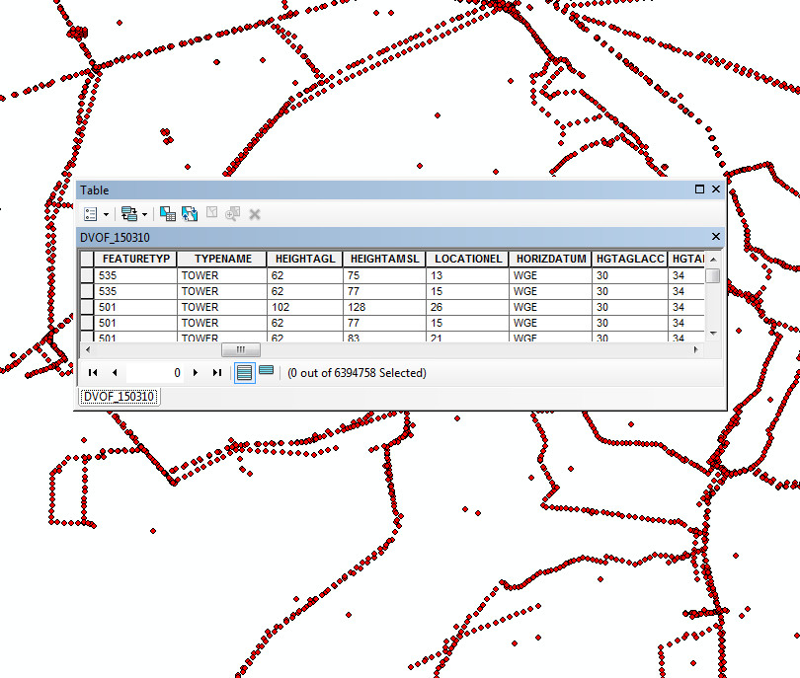
Inputs: Obstructions and Obstruction Field
Type: Point feature class
I recommend using the DVOF data from the G-Drive
CLIP this dataset to the maximum extent of inputs! (DVOF data is enormous)
Make sure there is an AGL height field of data type: integer (short or long)
If the height field is a string make a new field of type long and field calculate to populate it with integers from the string field

Slide 13
Inputs: Output Folder and GDB Name
The script will make a new GDB each time you run it
The model can overwrite output so you can technically re-run with the same parameters
I do not recommend this however
Sometimes Arc behaves unexpectedly and keeps schema locks on data (seemingly at random I have found) which will cause the model to crash
Copy a folder path into Output Folder and type in a valid GDB name into Output GDB Name

Slide 14
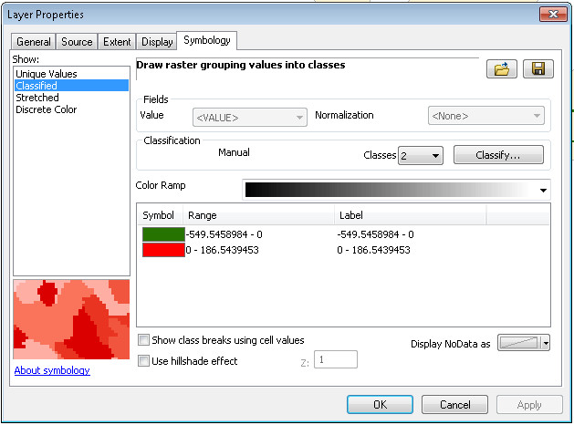
Output
The output will be a raster dataset representing potential areas of obstruction
Each raster cell is a floating point number that models the theoretical distance between the top of the obstruction and the approach surface
Negative numbers do not penetrate the surface, positive numbers do
Example
-200.239872… would be an obstruction about 200 feet below the AP
50.98123… would be about 50 feet above (penetrating) the surface
The closer to zero this value is the more likely you will want to verify by hand
No obstruction
Obstruction

Slide 15
Disclaimer: Be aware of the potential errors
If your centerlines are not flush with the APs the calculation will be off
If the projection of your inputs differs the model may crash
If the projection you choose does not have linear units in feet the calculation will be off
If your ANALYSIS_ID fields are different data types the model will crash
The model attempts to limit error from the Euclidean distance calculation by buffering your centerlines by 1 foot greater than the max width of the AP but some error still exists
Raster data model has inherent error, only as good as your inputs and limited by cell size
This model is only valid for the first 10,000 feet of the AP as it only uses the 50:1 slope, not the 40:1
THIS IS A HIGH LEVEL TOOL! VERIFY THE IDENTIFIED OBSTRUCTIONS BY HAND BEFORE TAKING FURTHER ACTION!

Slide 16
Toolbox Location
Import toolbox into ArcMap or navigate via catalog
Don’t copy locally
Run on ArcAdvanced VM
Path:
TODO

Slide 17
Questions
Chaz Mateer
cmateer@marstel-day.com

